Slide 1
Deadlock and handling of deadlock by OS
-Cherry Khosla

Slide 2
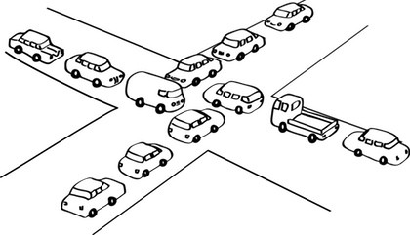
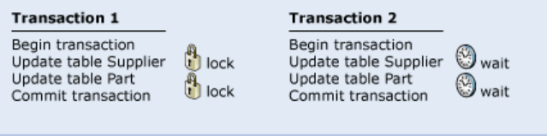

What is a Deadlock?
A
C
B

Slide 3
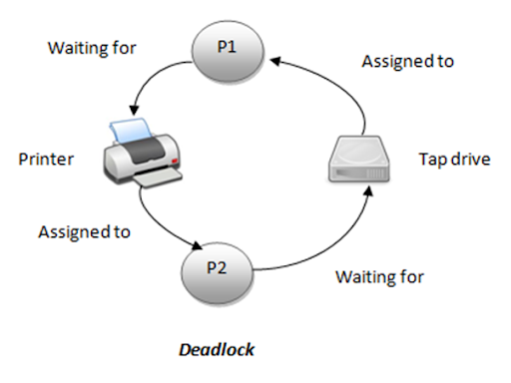
Deadlock
In a multiprogramming system, a number of processes compete for a limited number of resources.
If a resource is not available at that instant of time, then, a process enters into a waiting state.
If a process is unable to change its state indefinitely, it is known as a deadlock situation.
(because the resource(s) requested by
the process is/are held by
some other waiting process)

Slide 4
Necessary conditions for a deadlock to occur
Deadlock can arise in the system if following four conditions hold true simultaneously
  Mutual Exclusion: One or more than one resource are non-shareable (Only one process can use at a time)
  Hold and Wait: A process is holding at least one resource and waiting for resources.
  No Preemption: A resource cannot be taken from a process unless the process releases the resource.
  Circular Wait: A set of processes are waiting for each other in circular form.

Slide 5
Handling Deadlocks
Following are the ways to handle deadlock in the system
  Deadlock prevention
  Deadlock avoidance
  Deadlock detection and Recovery

Slide 6
Resource Allocation Graph
Deadlock can be described more precisely in terms of a directed graph called a system Resource Allocation Graph(RAG).
This graph is a diagrammatical representation of a deadlock in the system
The RAG consists of a set of vertices V and a set of edges E.
Vertices:
  P=(P1,P2,p3….Pn), the set consisting of all the active processes
  R=(R1,R2,R3….Rn), the set of resource types in the system
Edges:
  Request Edge
  Assignment Edge

Slide 7
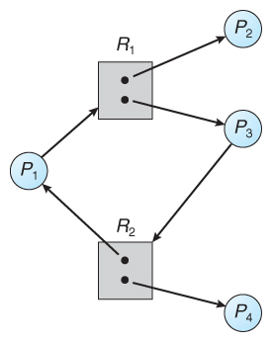
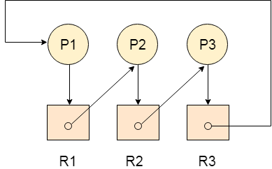
How RAG identifies Deadlock?
Cycle in a resource allocation graph is necessary but not sufficient condition for detection of a deadlock
NOTE: If every resource have only one instance in the RAG, then cycle in the graph is both necessary and sufficient condition for a deadlock detection.

Slide 8
Question
In a resource allocation graph, an edge from process Pi to resource Rj is known as
  Request Edge
  Assignment Edge

Slide 9
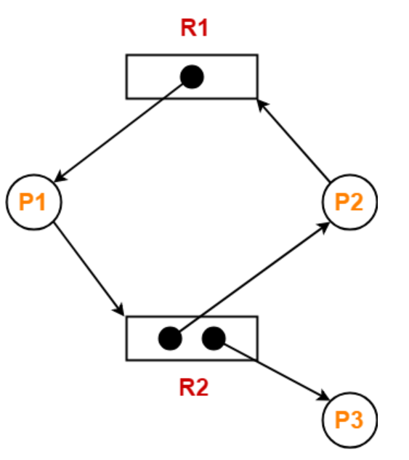
Example
Is there a deadlock in the system represented through RAG?

Slide 10
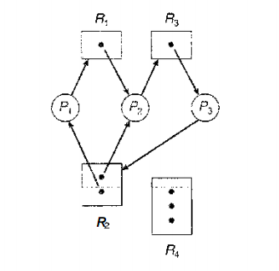
Example
Is there a deadlock in the system represented through RAG?

Slide 11
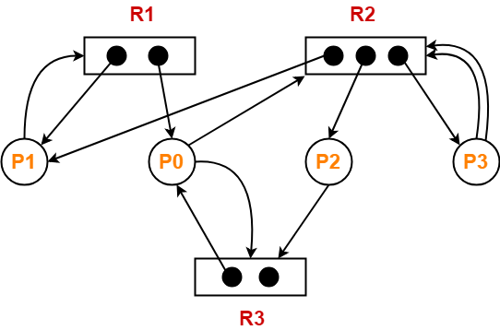
Example

Slide 12
Deadlock Prevention
Deadlock prevention provides a set of methods for ensuring that at least one of the necessary conditions cannot hold.
Mutual Exclusion
  Use sharable resources
Hold and wait
  Allocate all the resources initially
  allows a process to request resources only when it
  has none.

Slide 13
Deadlock Prevention
No-preemption
  We first check whether resources are available. If they are, we allocate them.
  If they are not, we check whether they are allocated to some other process that is waiting for additional resources. If so, we preempt the desired resources from the waiting process and allocate them to the requesting process. If the resources are neither available nor held by a waiting process, the requesting process must wait.
Circular Wait
  process requests resources in an increasing order of enumeration.

Slide 14
Practice Problem based on deadlocks
Consider there are n number of processes in the system P1,P2,P3….Pn where-
Process P1 requires x1 units of resources R
Process P2 requires x2 units of resources R
Process P3 requires x3 units of resources R and so on.
In worst case
  The number of units that each process holds= One less than its max demand

Slide 15
Two scenarios
1. Maximum number of processes that can participate to ensure no deadlock
2. Minimum number of units of resources required to ensures no deadlock

Slide 16
Question
A system is having 3 user processes each requiring 2 units of resource R. The minimum number of units of R such that no deadlock will occur?
3
5
4
6

Slide 17
Question
A system is having 3 user processes P1, P2 and P3 where P1 requires 2 units of resource R, P2 requires 3 units of resource R, P3 requires 4 units of resource R. The minimum number of units of R that ensures no deadlock is _____?

Slide 18
Question
A system is having 10 user processes each requiring 3 units of resource R. The minimum number of units of R such that no deadlock will occur _____?

Slide 19
Question
If there are 6 units of resource R in the system and each process in the system requires 2 units of resource R, then how many processes can be present at maximum so that no deadlock will occur?

Slide 20
Question
If there are 100 units of resource R in the system and each process in the system requires 4 units of resource R, then how many processes can be present at maximum so that no deadlock will occur?

Slide 21
Question
What is the minimum number of resources required to ensure that deadlock will never occur, if there are currently three processes P1, P2 and P3 running in a system whose maximum demand for the resources of same type are 3, 4, and 5 respectively.

Slide 22
Deadlock Avoidance
To implement the deadlock avoidance methods, the prior knowledge of the resources currently available, the resources currently allocated to each process, and the future requests and releases of each process is required.
The various algorithms that use this approach differ in the amount and type of information required.

Slide 23
Deadlock Avoidance
What is safe state?
  A state is safe if the system can allocate resources to each process (up to its maximum) in some order and still avoid a deadlock.
  More formally, a system is in a safe state only if there exists a safe sequence.

Slide 24
Algorithms/methods to be used
Single Instance- Resource Allocation Graph
Multiple Instances-Banker’s Algorithm

Slide 25
Resource Allocation Graph
This is a variant of previous resource allocation graph.
In this graph along with request and assignment edges we have claim edge.
  Claim Edge: A claim edge Pi — > Rj indicates that process P, may request resource R, at some time in the future.
  It is represented in the graph by a dashed line.
Like a request edge, a claim edge points from a process to a resource type.

Slide 26
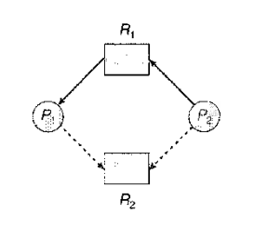
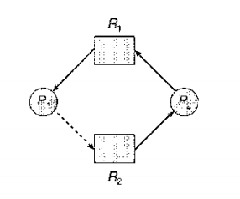
Claim Edge Representation

Slide 27
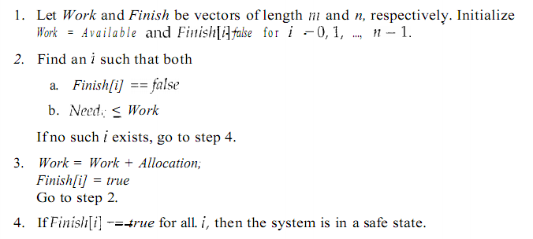
Safety Algorithm/Banker’s Algorithm

Slide 28
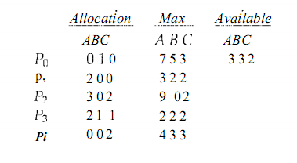
Example
Total Instances
A=10
B=5
C=7
4

Slide 29
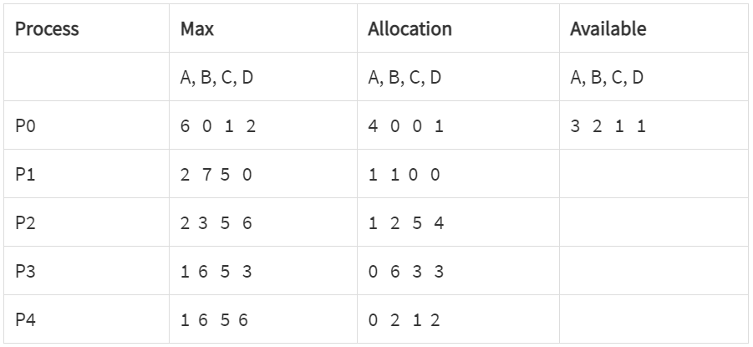
Practice Problem-1
Using Banker’s algorithm, answer the following questions:-
i) How many resources of type A, B, C, D are there?
ii) What are the contents of need matrix?
iii) Find if the system is in safe state? If it is, find the safe sequence.

Slide 30
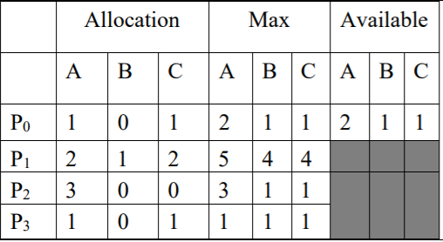
Practice Problem-2
Assume that there are three resources, A, B, and C. There are 4 processes P0 to P3. At T0 we have the following snapshot of the system:
Is the system in a safe state? Why or why not?

Slide 31
Resource Request Algorithm
Step-1 Check request <= need
Goto Step-2
Step-2 Check request<=available
Goto Step-3
Step-3 Available=Availabe-Request
Allocation=Allocation+Request
Need=Need-Request
Step-4 Check if new state is safe or not using Banker’s Algorithm

Slide 32
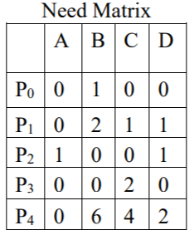
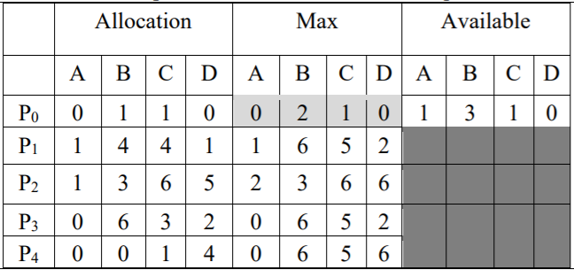
Example
If the system is in a safe state, can the following requests be granted, why or why not?
P1 requests (2,1,1,0)
P1 requests (0,2,1,0)

Slide 33
Deadlock Detection
If deadlock arise in the system, then system has to detect it. In deadlock detection we use the following methods
Methods:
  For Single Instance: Wait-for-graph
  For Multiple Instance: Variation of Banker’s Algorithm

Slide 34
Wait-For-Graph
An edge from Pi to Pj implies that process Pi is waiting for process Pj to release a resource that Pi needs
An edge Pi -> Pj exists in a wait-for graph if and only if the corresponding resource-allocation graph contains two edges Pi -> Rq and Rq ->Pj for some resource Rq

Slide 35
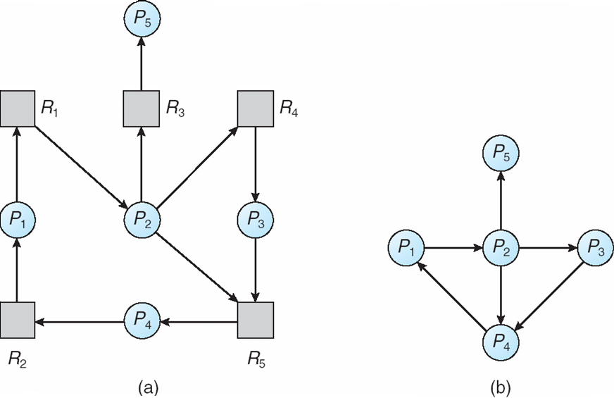
Wait-For-Graph

Slide 36
Example
R1
R2
P4
P2
P3
R3
P1

Slide 37
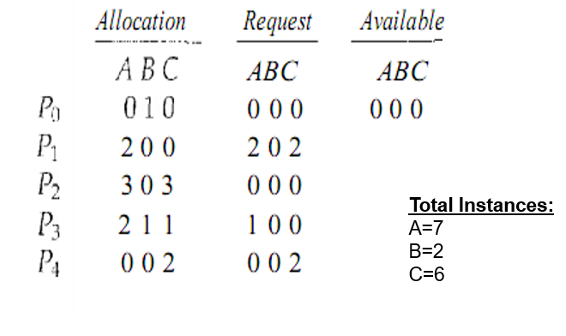
Banker’s Algorithm for Deadlock Detection
Available- A vector of length m indicates the number of available resources of each type.
Allocation- An n*m matrix defines the number of resources of each type currently allocated to a process. Column represents resource and resource represent process.
Request- An n*m matrix indicates the current request of each process. If request[i][j] equals k then process P_{i} is requesting k more instances of resource type R_{j}.

Slide 38
Recovery from Deadlock
When a Deadlock Detection Algorithm determines that a deadlock has occurred in the system, the system must recover from that deadlock. There are two approaches of breaking a Deadlock:
  Process Termination:
  Resource Preemption:

Slide 39
Practice MCQ questions
A deadlock situation can arise if which of the following conditions hold simultaneously in the system
I)Mutual Exclusion
II)Hold and Wait
III)No Preemption
IV) Circular Wait
Choose the correct option
Only I
I, II and II
Only II and III
I, II III and IV

Slide 40
Practice MCQ questions
2. To ensure deadlock never occurs, the system can use
Deadlock prevention scheme
Deadlock avoidance scheme
Deadlock detection and recovery scheme
1,2
1,2,3
3
2,3

